Slide 1
Implementation of ACO for TSP

Slide 2
Topics to discuss:
What is ACO ?
Applications of ACO
Travelling Salesman Problem
Algorithm
Formulae
Video Presentation

Slide 3
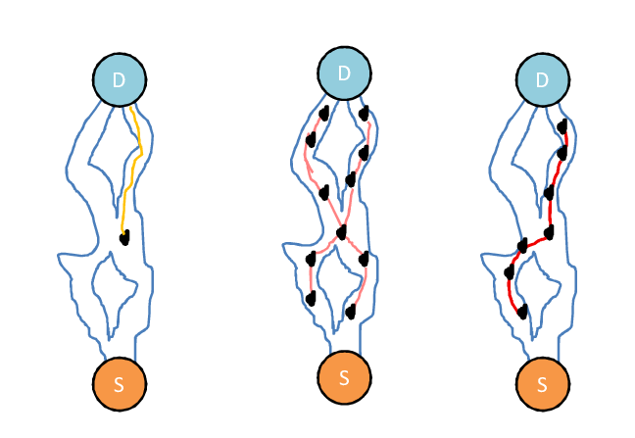
What is ant colony optimization ?
Optimization Algorithm
Probabilistic Approach
Working :
Nest to Food
Pheromone

Slide 4
Applications of ant colony optimization
Travelling Salesman Problem
Load Balancing in Telephone Networks
Ant Net
… many more

Slide 5
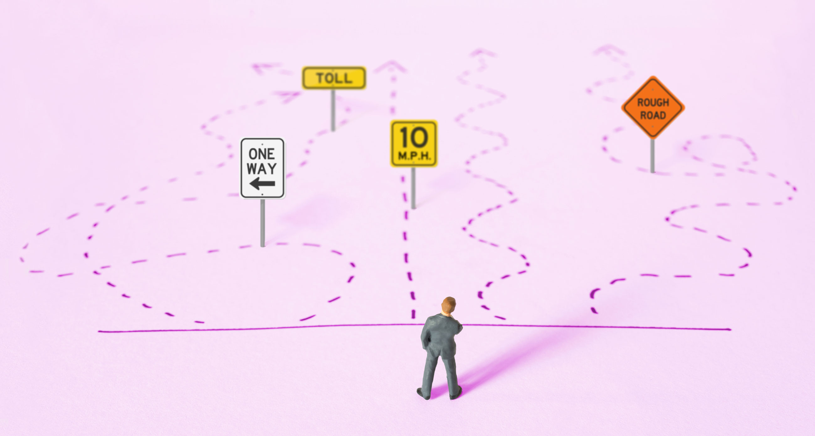
Travelling salesman problem
Salesman
Distance between cities
Optimized path
All city
Return to original city

Slide 6
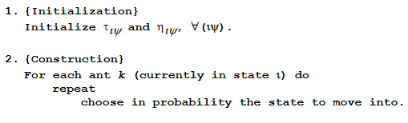
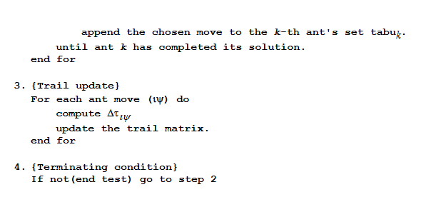
Algorithm for ACO

Slide 7
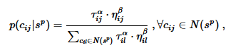
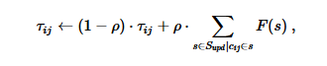
Formulae used in ACO algorithm
Ant Solution(Probabilities)
Update Pheromones

Slide 8
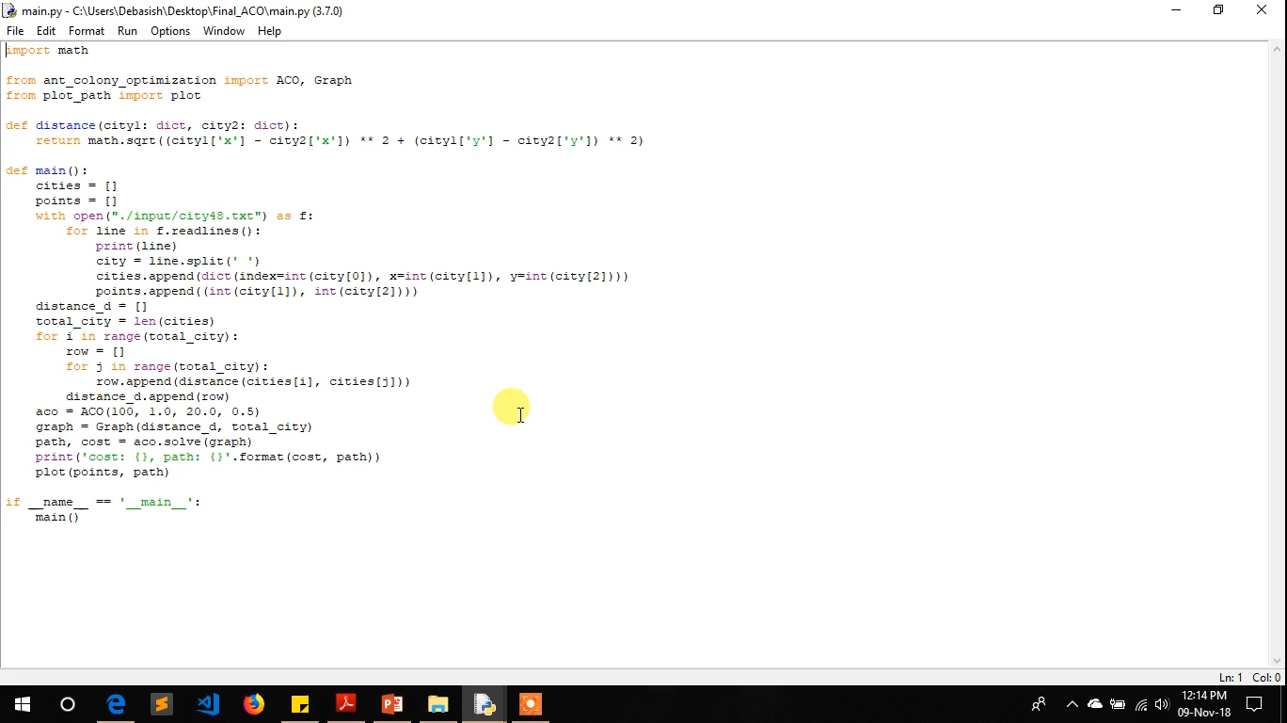
Video Presentation

